Slide 1
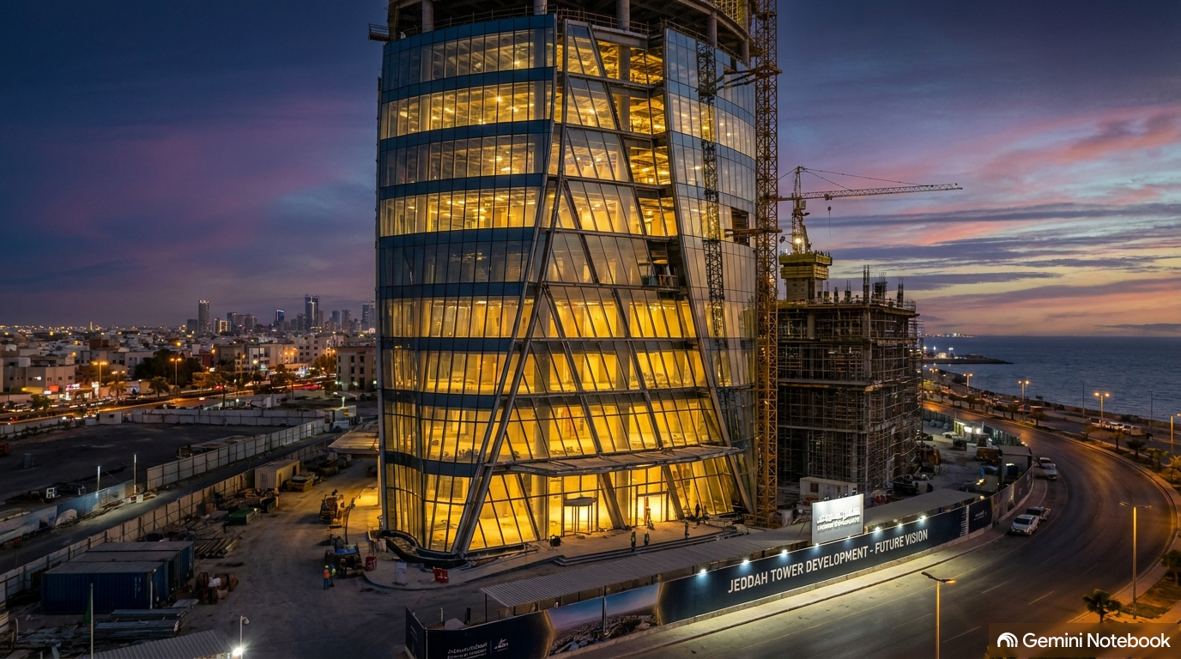
NEW VISION INTEGRAL
NEXT-GEN CONTRACTING & FACILITIES CARE
Pioneering 'Worry-Free Construction' & Turnkey Engineering Solutions Across Saudi Arabia.
ESTABLISHED
2024 (Jeddah)
SENIOR EXP.
35+ Years
LIFECYCLE
14 Stages

Slide 2
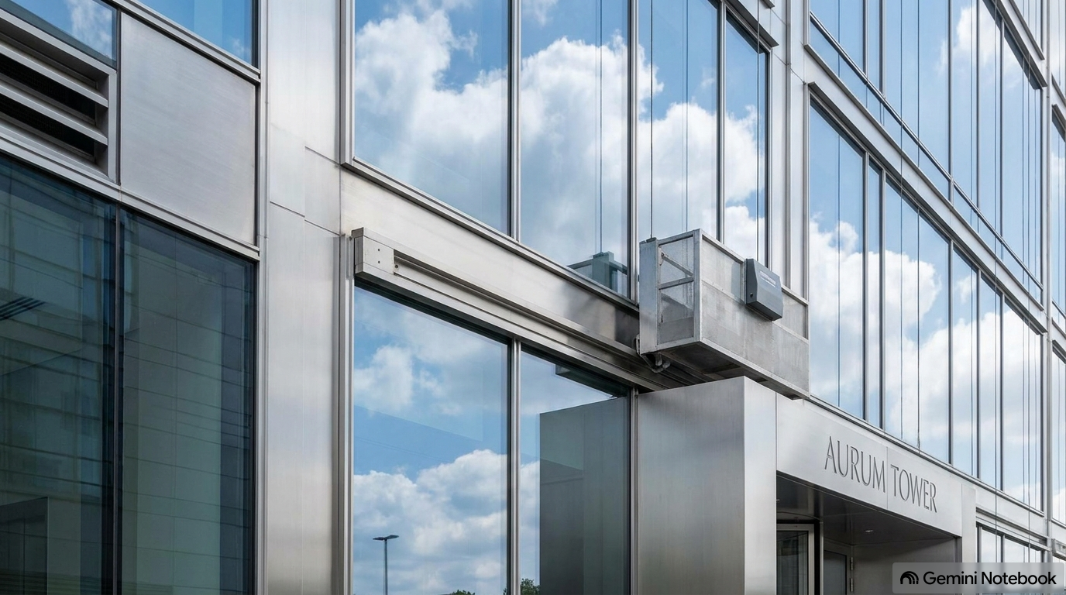
CORPORATE OVERVIEW
Executive Summary & Foundational Vision
01
Turnkey Building Solutions
Founded in 2024 in Jeddah, NVIMC delivers comprehensive, high-precision engineering, construction, and total facilities care tailored to modern Saudi commercial standards.
02
'Worry-Free Construction'
Built around complete project transparency, proactive communication, and strict adherence to client schedules, ensuring zero friction from inception to handover.
03
Preventive Maintenance Design
Integrating maintenance intelligence into early structural & MEP engineering designs to guarantee maximum asset longevity and long-term cost reduction.
HEADQUARTERS: JEDDAH, KINGDOM OF SAUDI ARABIA

Slide 3
STRATEGIC FOUNDATION
Vision, Mission & Operating Principles
OUR VISION
OUR MISSION
CORE VALUES
Kingdom-Wide Excellence
To be recognized across Saudi Arabia as the premier benchmark for high-precision construction and resilient facilities management, shaping modern infrastructure with zero compromise on quality.
Worry-Free Execution
Delivering flawless turnkey project execution by combining Tier-1 engineering expertise, transparent communication, and preventive maintenance frameworks that safeguard client investments.
Uncompromising Integrity
• Professional Integrity & Ethics
• Uncompromising Quality Control
• Environmental Sustainability
• Client-Centric Collaboration
• Lifelong Safety Standards

Slide 4
PROJECT GOVERNANCE
End-to-End 14-Stage Project Lifecycle
PHASE 1: STRATEGY & INITIATION
PHASE 2: SCOPING & DESIGN
PHASE 3: COST & RISK CONTROL
PHASE 4: EXECUTION & CLOSURE
1. Project Feasibility Study
2. Portfolio Alignment
3. Charter Development
4. Stakeholder Onboarding
5. Scope & Requirements
6. Work Breakdown (WBS)
7. Detailed Scheduling
8. Resource Allocation
9. Budgeting & Financials
10. Procurement Strategy
11. Quality & Safety Plan
12. Risk Management
13. Execution & Change Control
14. Final Handover & Closure
• Integrated Preventive Care
• Seamless Facility Transfer
100% LIFECYCLE GOVERNANCE: Guaranteeing zero friction, budget control, and complete transparency from blueprint to operations.

Slide 5
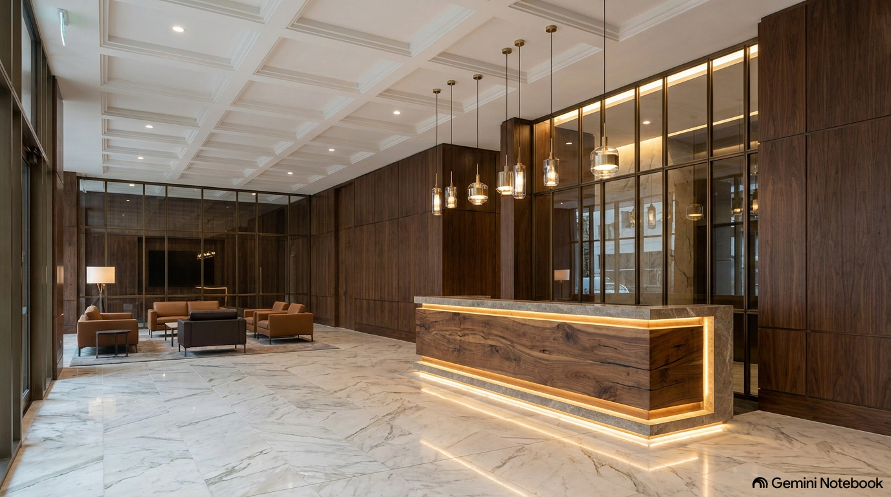
CONSTRUCTION & AESTHETICS
Structural Engineering & Interior Fit-Out
CIVIL & STRUCTURAL WORKS
Heavy Foundation & Structural Execution
• Reinforced Concrete Works & Foundations
• Structural Steel Fabrication & Erection
• Custom Architectural Landscaping & Hardscapes
• Exterior Facades & Waterproofing Systems
ARCHITECTURAL FIT-OUT & JOINERY
Luxury Spatial & Interior Craftsmanship
• Bespoke Woodworking & Executive Joinery
• Architectural Glass & Custom Metal Partitioning
• Gypsum Ceilings, Decorative Paneling & Tiling
• Turnkey Interior Finishes for Commercial Spaces

Slide 6
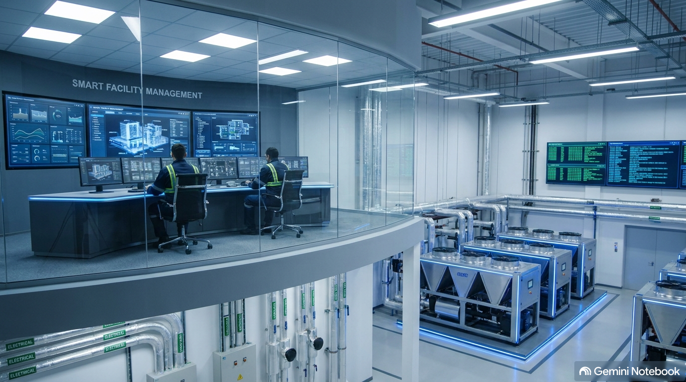
TECHNICAL INFRASTRUCTURE
MEP & Low-Current Systems Mastery
MECHANICAL & HVAC INFRASTRUCTURE
Heavy Industrial & Commercial Cooling
Chillers, Air Handling Units (AHU), Fan Coil Units (FCU), Ducts, Fire Suppression & Industrial Plumbing.
ELECTRICAL & POWER DISTRIBUTION
High-Precision Electrical Engineering
Main Distribution Boards (MDB), Sub-panels, Earthing & Grounding, Power Cabling & Emergency Systems.
SMART LOW-CURRENT & BMS
Integrated Building Intelligence
Building Management Systems (BMS), CCTV, Access Control, Fire Alarms, IP Telephony & Data Networks.

Slide 7
ASSET OPTIMIZATION
Total Facilities Management & Maintenance
FACADE & EXTERIOR CARE
High-rise exterior glass cleaning, structural cladding maintenance, weather sealing, and facade preservation.
MECHANICAL & HVAC UPKEEP
Preventive chiller servicing, AHU/FCU maintenance, pump overhauls, and air quality filter management.
LOW-VOLTAGE & NETWORKS
24/7 CCTV system audits, BMS optimization, access control maintenance, and data line integrity.
INTERIOR REFURBISHMENT
Ongoing fit-out repairs, wood/glass restoration, wall decor upkeep, and routine carpentry servicing.

Slide 8
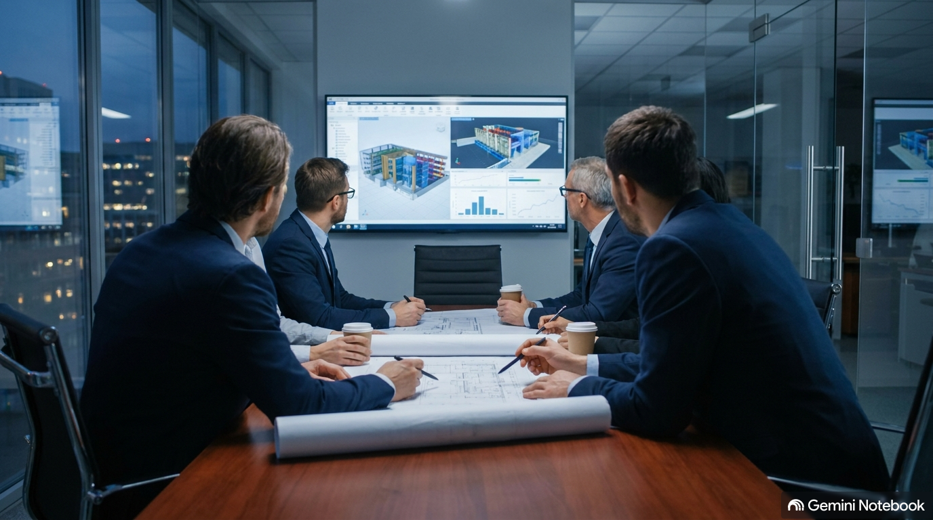
HUMAN CAPITAL
Tier-1 Executive Leadership & Technical Expertise
Azzam Al Sayeh — General Manager
Strategic direction, corporate growth, and operational governance.
Hazem Ghorbal — Project Manager / Civil Lead (35+ Yrs Exp.)
Decades of landmark contractor leadership, including Saudi Binladen Group.
Mohammad Khayat — Project Manager / Interior Lead (18 Yrs Exp.)
Expert in luxury commercial fit-out execution and spatial design.
Anas Khayat & Systems Team — PM Network Lead (15 Yrs) & Engineering Leads
Electrical Lead (11 Yrs) & Mechanical Lead Nader Abdulhadi (5 Yrs).

Slide 9
NEW VISION INTEGRAL FOR MAINTENANCE & CONSTRUCTION
Partner with Us for 'Worry-Free Construction'
HEADQUARTERS: Jeddah, Kingdom of Saudi Arabia
COMMERCIAL INQUIRIES: Corporate Contracting & Turnkey Projects
GENERAL MANAGER: Azzam Al Sayeh
CIVIL & PROJECT LEAD: Hazem Ghorbal
WEBSITE & COMMINUCATIONS: Available via official NVIMC corporate channels

